Slide 1
TNE group project

Slide 2
Project aim
Clinical problem
Neuroscience
Computation
Neuroengineering
Patients

Slide 3
Project overview
60% of final grade
  Project presentation = 40%
  Written project report = 20%
Abstract -> submit to moodle in week 3 (6th March)
  Feedback from profs in week 4
Presentation rehearsal to TAs -> week 11 (8th May)

Slide 4
Goal of today’s exercise
Brainstorm with TAs
  Clinical problems (neurological disorders) & their current treatments
  Neurotechnologies that could be applied to these patients
Read relevant literature for next week
  Divide topics between group members

Slide 5
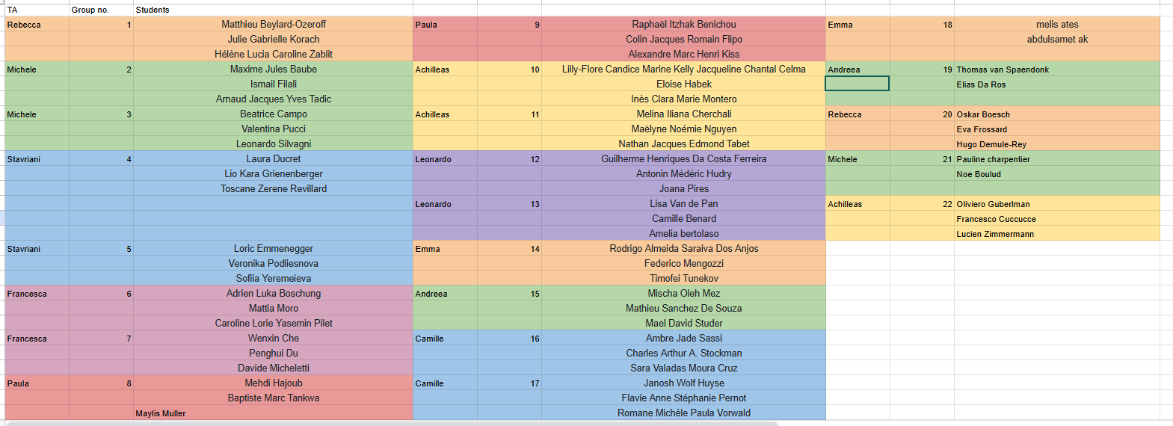
Groups - TAs

Slide 6
Groups - TAs
Rebecca – rebecca.jones@epfl.ch
Stavriani - stavroula.skarvelaki@epfl.ch
Michele - michele.diponzio@epfl.ch
Francesca - francesca.barcellini@epfl.ch
Andreea - andreea-maria.gui@epfl.ch
Leonardo - leonardo.pollina@epfl.ch
Achilleas - achilleas.laskaratos@epfl.ch
Camille - camille.frayssinhes@epfl.ch
Paula - paula.sanchezlopez@epfl.ch
Emma - emma.farina@epfl.ch

